Slide 1
The Meiji Restoration
Japan 1868

Slide 2
The EDO (Tokugawa) Period (1603-1867)
During this time period Japan was ruled by the military or “Shogunate”
A Political Revolution in 1868 removed the Shogunate from power and returned control to the Emperor.

Slide 3
EMPEROR Mutsuhito Meiji :
After power was established within the emperor’s hands, Meiji presided over a period of modernization and westernization called the:
MEIJI RESTORATION

Slide 4
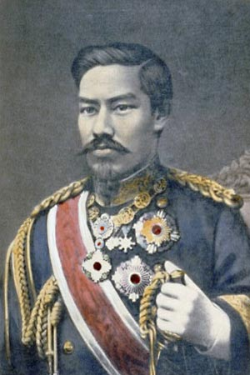
Emperor Meiji
The restoration started with a coup de’tat in the ancient imperial city of Kyoto.

Slide 5
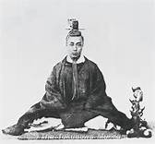
TOKUGAWA YOSHINOBU : “The Last Shogun”
The last Tokugawa Shogun fought a brief war against imperial forces but was defeated and removed from power in 1869

Slide 6
REASONS for the Coup de’tat :
Foreign powers were threatening to forcibly open Japan up to western influence
Japanese citizens, witnessing what happened to nearby China, wanted to “enrich the country and strengthen the army” (quote from the Meiji Emperor)

Slide 7
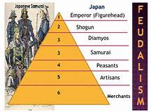
ENRICH THE COUNTRY ????
First …..
END Feudalism

Slide 8
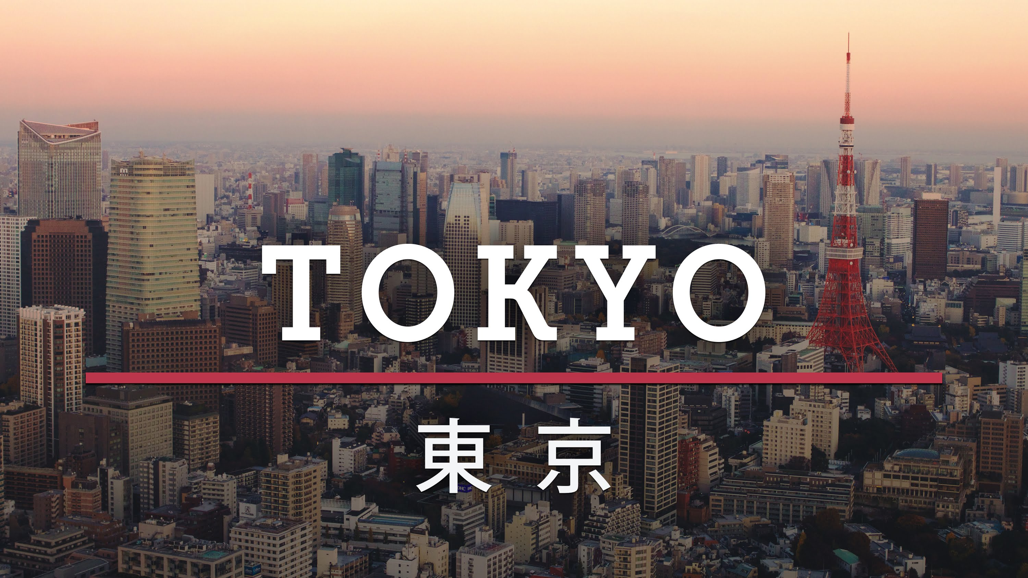
Second,
Move the capital from Kyoto to Edo
(renamed “Tokyo” or “eastern capital”)

Slide 9
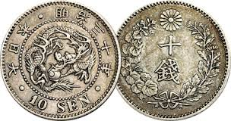
Third……
Establish a national tax system for the first time to create social services that help Japanese citizens.
(taxes were previously collected sporadically and depending on the local Diamyo)

Slide 10
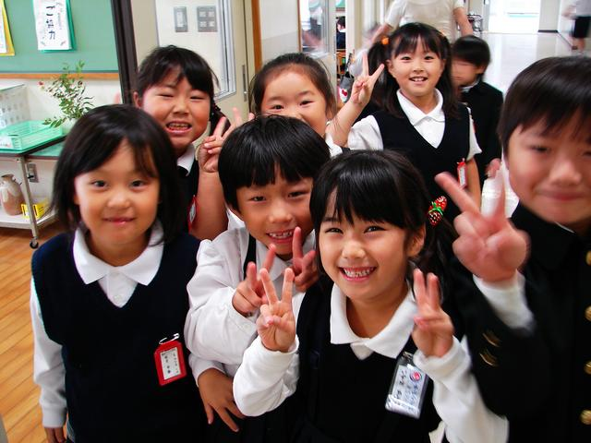
and FOURTH …….
Universal Education was a promise made to all Japanese.
There was a focus on Western learning.

Slide 11
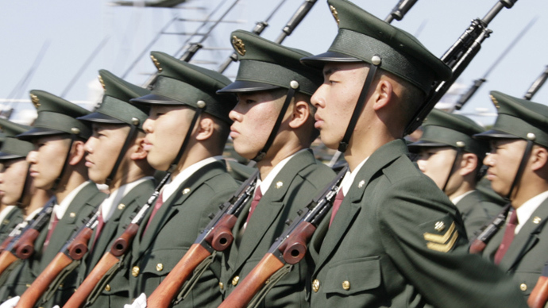
NEXT : Strengthen the Army
The first National Army was formed
Conscription was put into place during times of elevated threats

Slide 12
So… What did the Meiji Restoration accomplish ?
1. 1890 - Japan had a constitution
* The Meiji Emperor became the spiritual leader of Japan
* A Bi-Cameral Parliament called the “Imperial Diet”
handled the day to day governance
* Voting rights existed, but were limited.
* An elected Assembly counseled the government

Slide 13
Japan grew in strength :
Taking some ideas from the west to compliment traditional Japanese culture, Japan began to industrialize, modernize, educate their society :
* 1894, State-Sponsored Industrialization begins
* they form the Anglo-Japanese Alliance
in 1902

Slide 14
Military victories followed :
1895 - Japan defeats China in a war for
access to Manchuria
1905 - Japan defeats Russia in the Russo-Japanese War
also over access to the mainland
1905- 1912 Japan begins its expansion and controls a
large empire with continental holdings and
control over many islands in the Pacific

Slide 15
By 1914 …..
Japan is a formidable, expansionist power in Asia, with a strong economy. By the beginning of World War I (and Japan’s entry into the war) the period called the MEIJI RESTORATION is over.

Slide 16
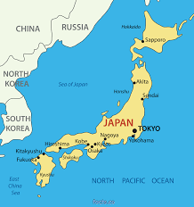
Why is the Meiji Restoration a key period in Japanese history ?

