Slide 1
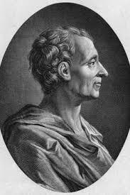
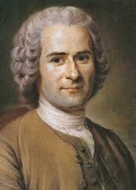
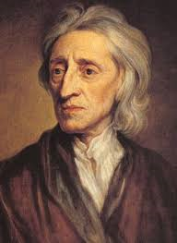
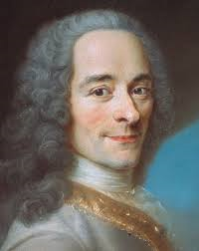
18th Century Liberalism
Montesquieu Rousseau Locke Voltaire

Slide 2
The end of Hereditary
Monarchies

Slide 3
2. Citizens should be part
of their government,
through
VOTING RIGHTS ……..

Slide 4
3. …. FREEDOM
of
SPEECH

Slide 5
…..and
FREEDOM
of
THE PRESS

Slide 6
SECULARISM
( THAT’S THE SEPARATION OF CHURCH and STATE )

Slide 7
6. The main role of the
government should
be to protect the
rights of its citizens

Slide 8
All rights should be
codified (written down)
in a constitution.

Slide 9
8. Citizens should have the
right to petition or
criticize their government

Slide 10
9. There should only be social
distinctions based on utility.
(From “The Declaration of the Rights of Man and Citizen”)
* this means that all citizens are equal. Those that have
special rights are only because they serve the public.
for example : police and fire fighters

Slide 11
There should be “economic
freedom.”
(in other words, a free market, where people
can produce, buy and sell whatever they choose)

Slide 12
There should be
PROPERTY RIGHTS
Any citizen should be able to pursue and legally
obtain and hold property.
(Locke wrote extensively about this)

Slide 13
12. A true liberal government
should be a reflection of the
desires of the people.
- ?
Baron von Montesquieu

Slide 14
A large part of Political Liberalism
concerns OBLIGATIONS.

Slide 15
OBLIGATIONS
This is what we owe other people in our society
Citizens in a politically liberal society can enjoy all of
their rights UNLESS in the course of the exercise of rights
we injure or harm someone else.

